Slide 1
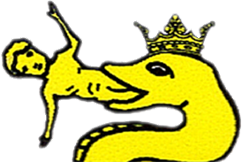
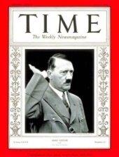
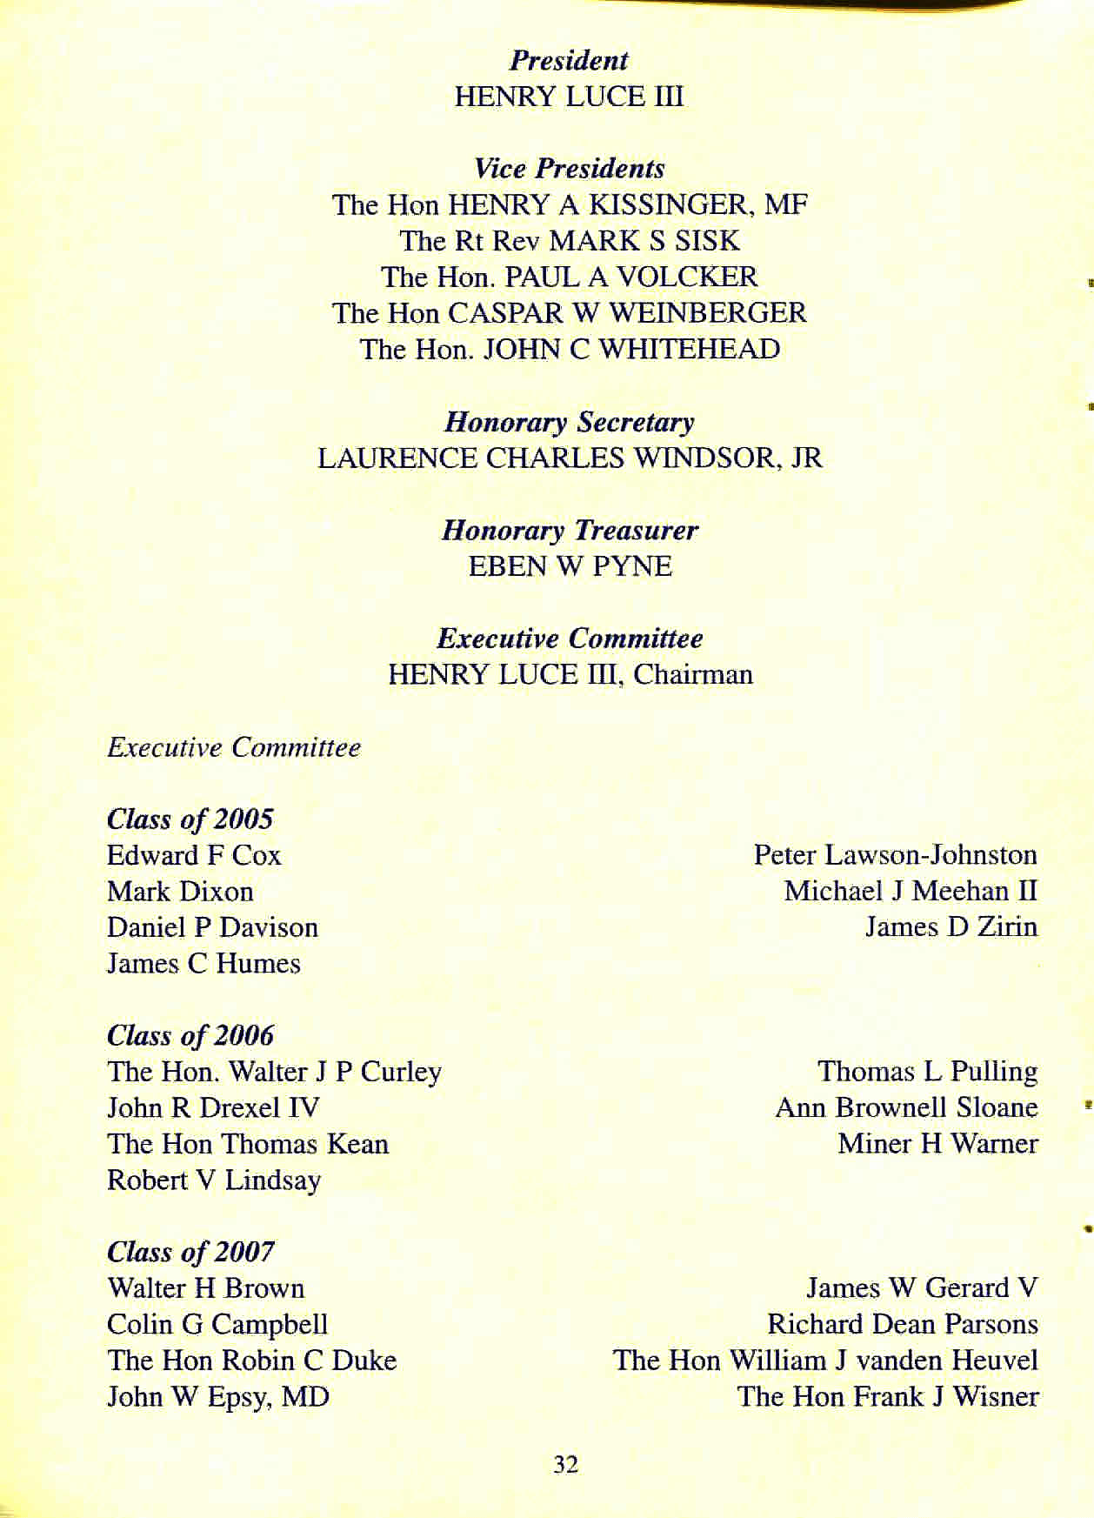
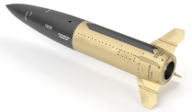
These people are the likely real organizers of the 9/11 false flag that ushered in The Patriot Act suspension of the Bill of Rights
Fauci’s ancient maternal Swiss ABYSS family crest
From the 2004 British Pilgrims Society official Officers and Membership List (TheCityofLondon), this is the Pilgrims of the United States of America controlling Executive Committee
This never-before-seen secret list was likely put up for auction on eBay unwittingly by the heirs of a Pilgrim who died.
Henry Luce III: Time, Life,
Sports Illustrated, Fortune
CEO
Mark Sisk: Anglican Bishop of NY
Paul Volcker: Fed Reserve chair (Carter, Reagan), Bank “bailout” chair (Obama), U.S. Treasury, Chase bank, Rockefeller Group, killed gold standard, OPIC slush, Fannie Mae, Trilateral Comm founder, Bilderberg Group, LSE communist, KPMG-Volcker King’s secret “covered” accounts (London) for insider trading
Henry Kissinger: Knight; US Secretary of State, Rockefeller Bros, trained spy, Harvard, National Security Council, Council on Foreign Relations (CFR), Bilderberg, Bohemian Grove, Atlantic Council, Aspen Institute, Theranos blood director
Caspar Weinberger: Knight; US Secretary of Defense (Nixon), Iran-Contra scandal, FTC chair, OMB chair, Cambridge, Harvard
John Whitehead: Lower Manhattan Dev Corp chair, Fed Res of NY chair, Brookings Inst director, NYSE director, Rockefeller Trust, American Academy of Achievement, Harvard, Bilderberg Group, Goldman Sachs
Laurence Windsor Jr:
Marines; Young & Rubicam Army (Advertising) Grp, Civilian aide to Sec of Army (Clinton), Vets Corp managing dir of comms
We have allowed these criminals to kill off humanity in bankers’ wars
Eben Pyne: Citibank pres*, Bankers Trust, Princeton, Rockefeller Foundation, WR Grace & Co chemicals director
John Drexel III: Grandson
of British Pilgrim Exec Committee 5th Baron Cambys, Kidder, banker, Peabody & Co (UBS AG), GE Capital, Paine Webber, Columbia, wife Jackie Astor
Miner Warner: London School of Economics (communist), Harvard, Salomon Bros London, vp, Merrill Lynch director, Council of Americas (Rockefeller), Pilgrims president 2007-
Reproduced for educational purposes only. Fair use relied upon.
Secretary.(Jan. 28, 2004). Pilgrims Society Officers and Membership List, p. 32 of 52, Allington Castle, Maidstone, Kent ME16 0NB. The Pilgrims Society, eBay.

