Slide 1
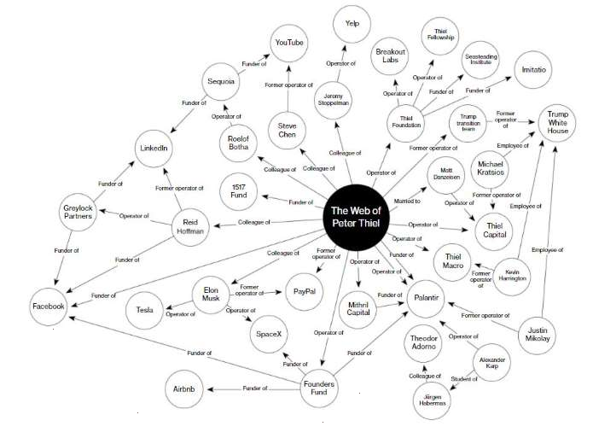
Alibaba
The Highly Duplicitous World of Peter Thiel
Here’s the rest of the picture (in red) that the preparer of the black & white portion left out. Why? This appears to be a PsyOp. Warn Pres. Trump.
IDG-Accel Capital (China)
Vanguard
HSBC
Wells Fargo
Funders of
Roths-childs
Goldman Sachs
ABC, CBS, NBC, WaPo, CNN, NYT
Funder of
Baidu
Bank of America
T. Rowe Price
Morgan Stanley
John P. Breyer (China)
Win In China LLC Hong Kong
JP Morgan Chase
TIAA-CREF
Fidelity
Supplier to
Deal flow to
Bank of New York
NVCA*
Deal flow to
Supplier to
Deal flow to
Funder of
C.I.A. In-Q-Tel
Accel Partners
Deal flow to
Co -
creator of
Chair of
Owner of
James W. Breyer
Bill of Rights Criminals
Director
Supplier to
Supplier to
Funder,
Director of
Deal flow to
Director
Deal flow to
Supplier to
Supplier to
Why is the black version probably a PsyOp? Look at the elephants in the room: Nothing about NSA, CIA, James W. Breyer, Accel Partners, In-Q-Tel, China, IDG, NVCA deal flow, In-Q-Tel deal flow, etc.
Supplier to
NSA
* National Venture Capital Association
Supplier to
Go to the Crimeline for hard evidence of these Thiel relationships : http://www.fbcoverup.com/docs/cyberhijack/cyber-hijack-findings.html

